Slide 1
Pizza Sales Analysis Using SQL
Presented by : Chandra Kumar Reddy

Slide 2
INTRODUCTION
Hello, I am Chandra Kumar, a passionate data analyst. In this project, I analysed pizza sales data using SQL to provide business insights for optimizing revenue and understanding customer preferences.

Slide 3
Key Metrics
Total Sales and Revenue
Popular Pizza sizes , types and categories
Time based ordering trends and revenue organizing

Slide 4
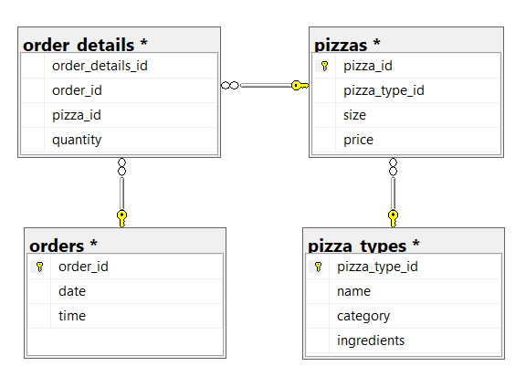
Understanding the Database Structure
Entity-Relationship Diagram

Slide 5
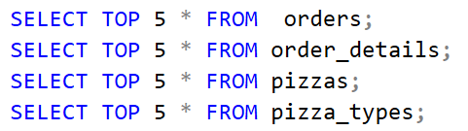
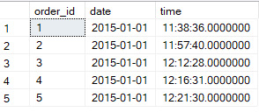
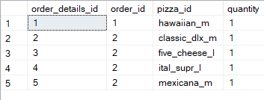
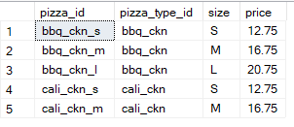
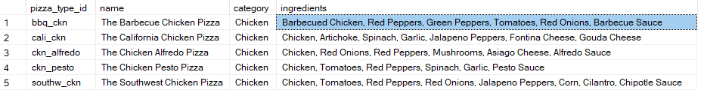
Understanding the Data
Queries
Orders
Order_details
Pizzas
Pizza_types

Slide 6
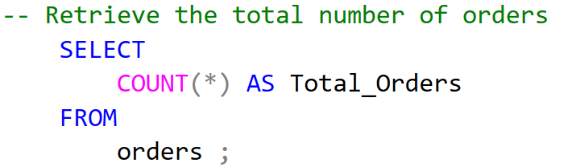

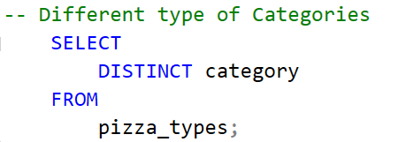
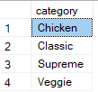
Total number of orders and different types of pizza catogories

Slide 7

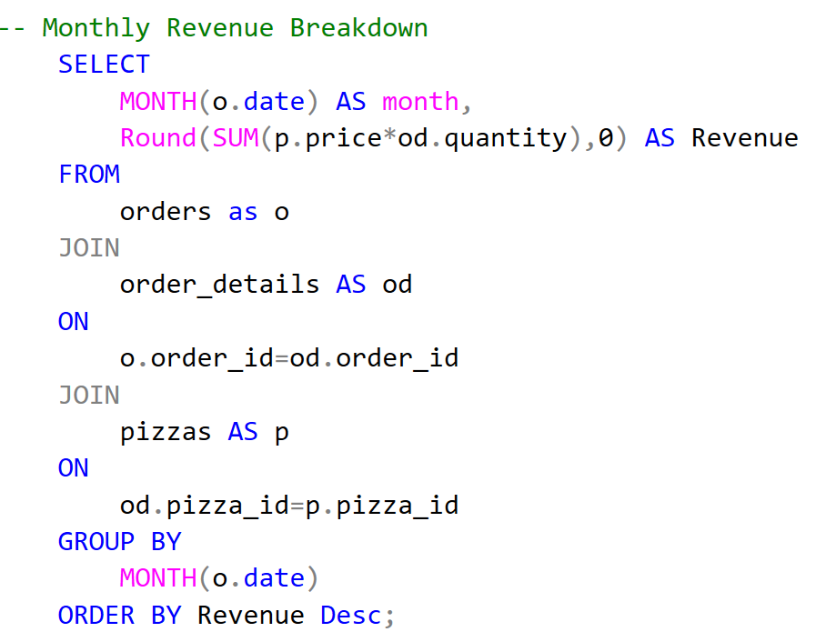
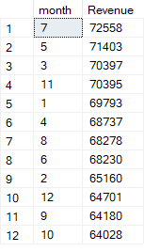
Revenue By Month
Insight:- Revenue is more in July followed by May and March

Slide 8
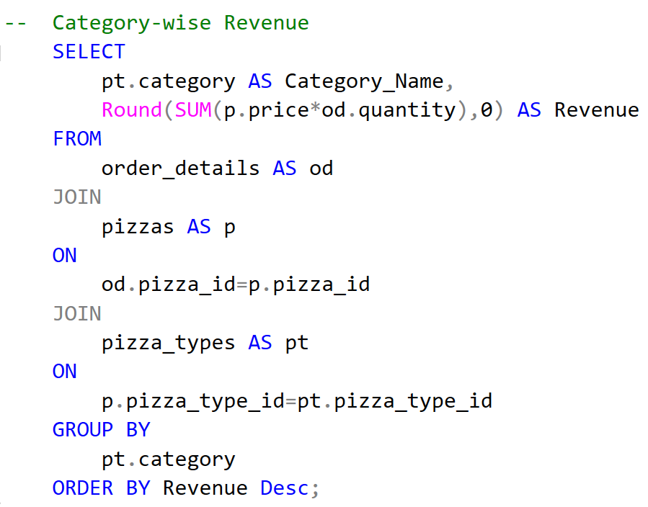
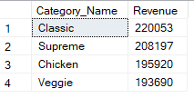
Category – Wise Revenue
Insight:-
Classic Category is generating Highest revenue followed by Supreme, Chicken and Veggie

Slide 9
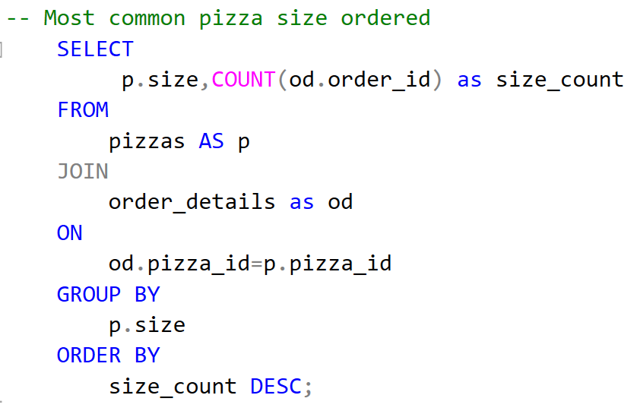
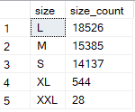
Most Common Pizza Size Ordered
Insight:-
Large (L) size pizza is the most popular choice among customers followed by Medium (M), Small (S), Extra Large (XL) and Extra Extra Large (XXL).

Slide 10
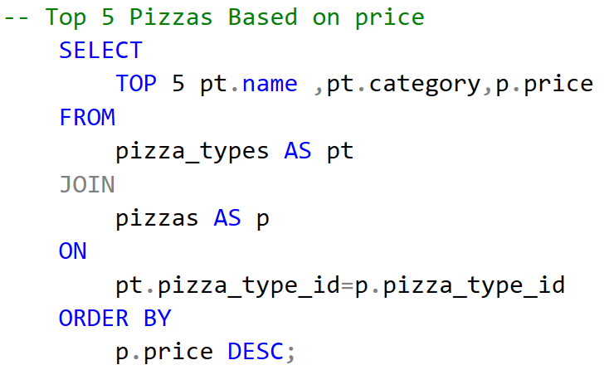
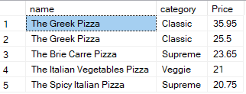
Top 5 Pizzas Based On Price
Insight:-
The top 5 most expensive pizzas are dominated by the Classic and Supreme categories.

Slide 11
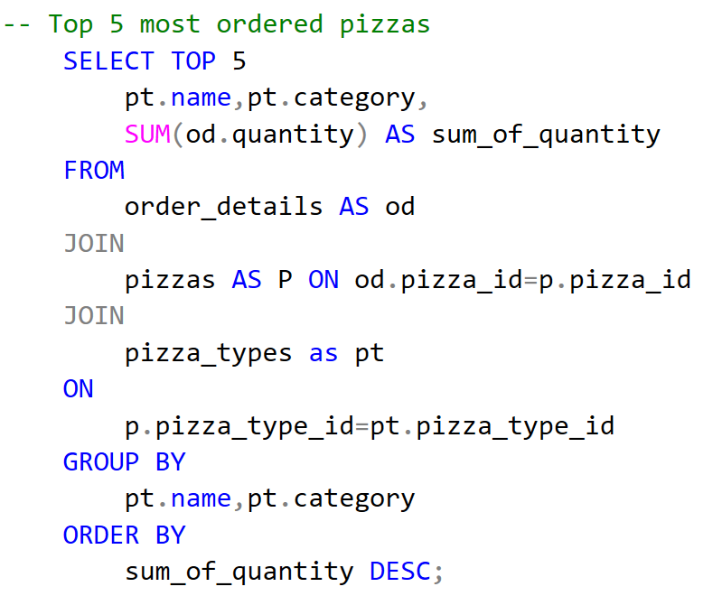
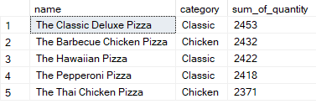
Top 5 Most Ordered Pizzas
Insight:-
The top 5 most ordered pizzas are led by the Classic Deluxe Pizza, with Classic pizzas dominating the list (3 out of 5), while the popularity of Chicken pizzas like the Barbecue Chicken Pizza and Thai Chicken Pizza highlights strong customer demand for meat-based options.

Slide 12
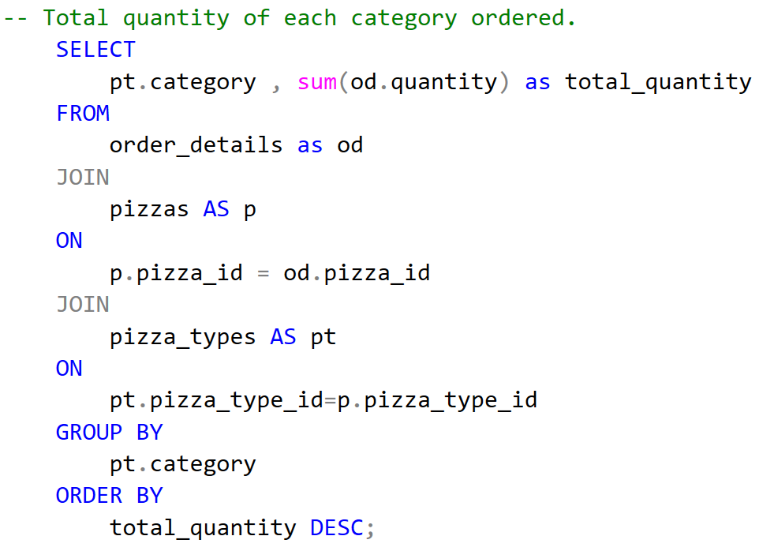
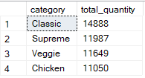
Total Quantity Of Each Category Ordered
Insight:-
The Classic category leads reflecting its widespread popularity, while the Supreme and Veggie categories show strong compe-tition for second place, Meanwhile, the Chicken category trails slightly but still maintains significant demand.

Slide 13
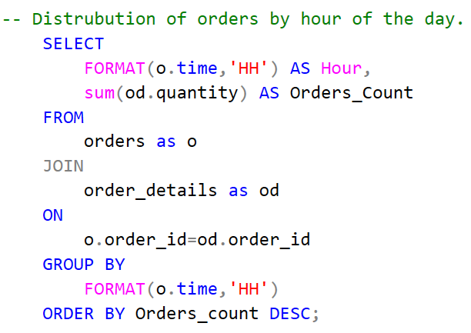
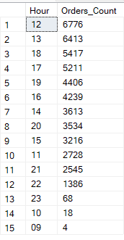
Order Distribution by Hour of the Day
Insight:- The leading hours for orders—12 PM, 1 PM, 6 PM, 5 PM, and 7 PM—indicate peak activity around lunch and dinner times, aligning with typical meal schedules.

Slide 14
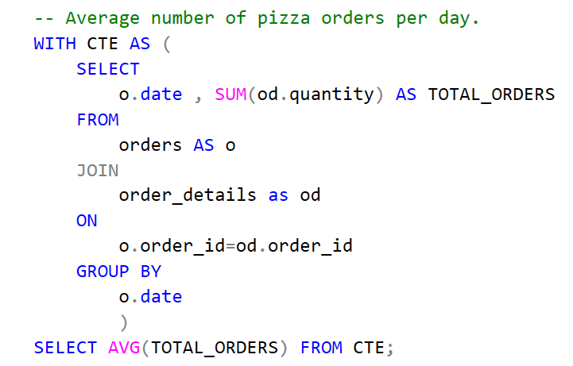

Average number of pizza orders per day
Insight:- The average of 138 orders per day indicates a substantial volume of daily orders. This is helpful for understanding the overall demand for pizzas and planning for inventory, staffing, and operational resources.

Slide 15
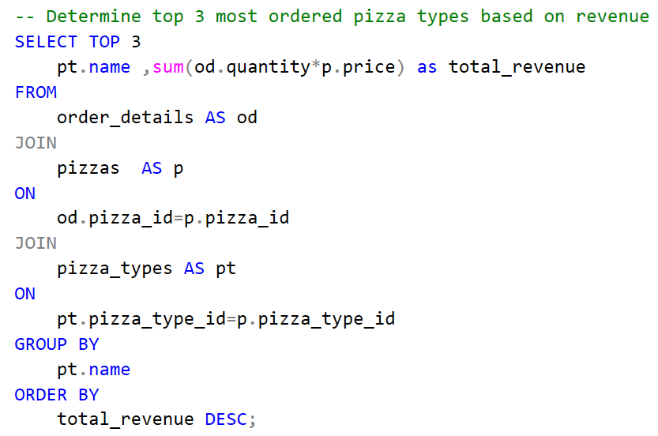

Top 3 most ordered pizza types based on revenue
Insight:-Thai Chicken Pizza, Barbecue Chicken Pizza, and California Chicken Pizza are the top revenue-generating pizzas suggests that chicken toppings are highly preferred by customers.

Slide 16
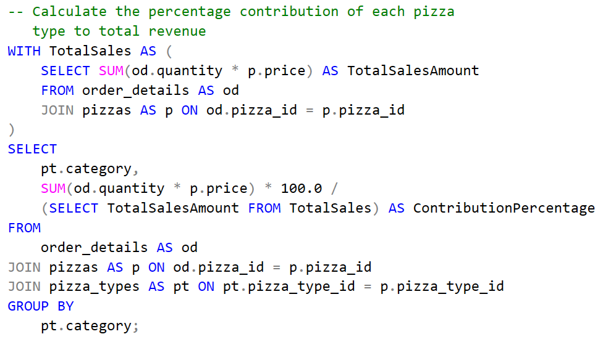
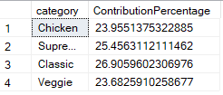
percentage contribution of each pizza type to total revenue
Insight:-The Classic category contributes the highest revenue. This indicates a balanced demand across pizza categories, with Classic pizzas being the most popular choice.

Slide 17
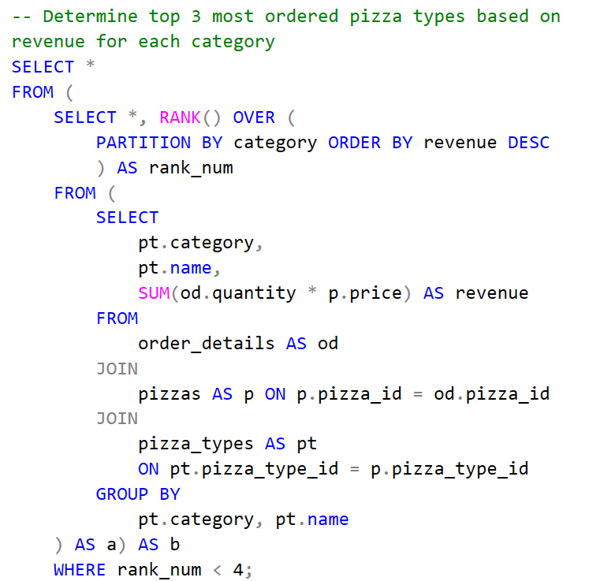
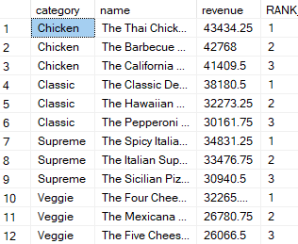
Determine top 3 most ordered pizza types based on revenue for each category

Slide 18
Conclusion:
Our analysis provides key insights into pizza sales trends, customer preferences, and revenue distribution. July, May, and March emerge as the highest revenue-generating months, indicating potential seasonal trends. The Classic category leads in revenue, showcasing its widespread popularity, while Supreme, Chicken, and Veggie categories compete closely.
Large-sized pizzas (L) are the most preferred among customers, followed by Medium (M) and Small (S) sizes. The dominance of Classic and Supreme categories among the most expensive pizzas suggests premium pricing potential, while Classic Deluxe Pizza and other Classic varieties remain the top choices, reinforcing their demand. However, the strong performance of Chicken pizzas, particularly Barbecue Chicken and Thai Chicken Pizza, highlights a significant preference for meat-based options.
Peak order hours—12 PM, 1 PM, 5 PM, 6 PM, and 7 PM—align with lunch and dinner times, helping optimize staffing and inventory planning. The average of 138 orders per day indicates a substantial daily sales volume, requiring efficient operations.
Overall, the findings suggest a well-balanced demand across pizza categories, with Classic pizzas leading, while Chicken and Supreme pizzas also enjoy strong customer appeal. These insights can guide menu optimization, pricing strategies, targeted promotions, and resource planning to maximize sales and improve customer satisfaction.

Slide 19
THANK YOU
M. Chandra Kumar Reddy mandireddychandrakumar@gmail.com

